Slide 1
Bringup Process
At the moment the start-up process is:
1183 roslaunch /home/tractor/catkin_ws/src/nmea_navsat_driver/launch/nmea_to_odom.launch
1184 roslaunch /home/tractor/catkin_ws/src/lawn_tractor_sim/launch/ros1_navigation.launch
1270 $ roslaunch /home/tractor/catkin_ws/src/lawn_tractor_sim/launch/mbf.launch
965 source devel/setup.bash
Debugging tools:
  880 rosrun tf2_tools view_frames.py && evince frames.pdf

Slide 2
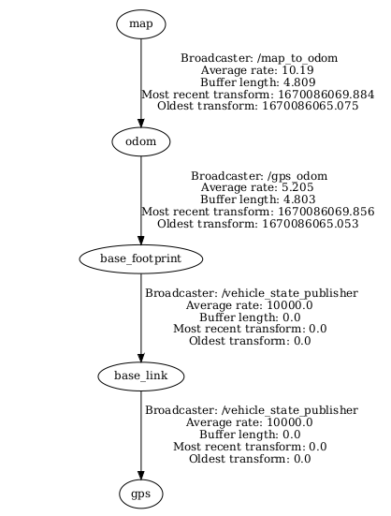
Debugging tools
880 rosrun tf2_tools view_frames.py && evince frames.pdf
501 rosrun rqt_graph rqt_graph

Slide 3
